Slide 1
CALUMO TRAINING
Robert Mulroney
Calumo Consultant

Slide 2
What is Calumo?
Web / Mobile Financial reports
MS-Office integrated reporting
Author reports in excel
Planning & Forecasting
Month End reporting
Report preparation – Build once use forever – Automate
HR Reporting
Executive reports
Dashboards
Data-visualization
Sensitivity & What-if Analysis
KPI Management
A single source of truth.
CALUMO makes it easy for you to deliver outcomes to the business

Slide 3
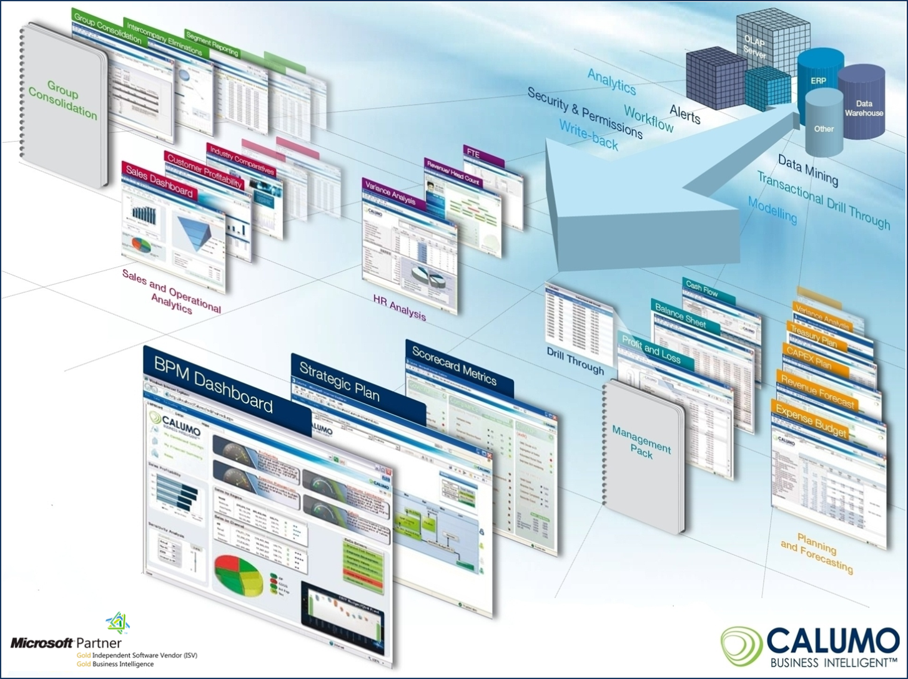
BI for Finance

Slide 4



















Architecture
Triggers
Operational Reporting
Planning
Forecasting
Ad-Hoc Analytics
Scorecards
Dashboards
Work Flow/ Alerting
Statutory Reporting
Modes
CALUMO Client (Ribbon)
CALUMO Client (Zero Footprint)
Interface
Authoring
Desktop apps
Browsers
Cloud
CALUMO-as-a-Service
Agile | Secure | Scalable | Rapid | Cost effective
Source

Slide 5
The Language of Calumo
Cube - Cube is a multi dimensional data structure composed of dimensions and measure groups. The intersection of dimension and measure groups contained in a cube returns the dataset.
Measure - Literally it refers to measured data such as measured dollars or number of sales. A unit-bearing data type – The types of numbers stored in the cube.
Dimension - A collection of members, positions, or units of the same type. In a multidimensional data set, every data point is associated with one and only one member from each of multiple dimensions. Dimensions are frequently organized into one or more hierarchies, though this is not a logical requirement.

Slide 6
The Language of Calumo
Member - An element, position, or unit within a dimension.
Hierarchy - An organization of members into a logical tree structure, with each member having at most one “parent” member and an arbitrary number of “children” members.
Slice / Slicer – a Filter / filtered set. A slice is a subset of a multi-dimensional array. The set of data associated with the selected Dimension members.
Drill-up/down - Navigating towards/away from the root of a hierarchy.

Slide 7

The Cube is a Lie
Cube – a delicious cake of data.
Dimension – the knives by which the cake is cut.
Member – the lines on which the cake is cut.
Hierarchy – layers of the cake.
Slice – the piece I’m eating.

Slide 8
Calumo@Summit Care

